Slide 1

Neurodiversity:
Experiences & Perceptions

Slide 2


Reflection Activity
Choose one of the following questions:
Can you share an experience that you have in relation to Neurodiversity?
Can you share an assumption you have noticed about Neurodiversity?
Neurodiversity: Experiences & Perceptions

Slide 3


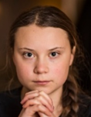







Neurodiversity: Experiences & Perceptions
Dyslexia
Dyslexia
Bi-Polar
Aspergers (ASD)
ADHD
Dyslexia
ADHD
Each of these individuals are neurodiverse

Slide 4
Neurodiversity: Experiences & Perceptions
All of them are talented and successful, yet their neurodiversity is rarely something that is linked to this
Part of the reason for this is the way society teaches us to view neurodiversity is linked d to this

Slide 5

Neurodiversity: Experiences & Perceptions
The following conditions fall under the umbrella
of neurodivergence:
• Anxiety
• Depression and mood disorders
• PTSD
• ADHD
• ADD
• ASD (autism and Aspergers)
• Dyslexia
• Dyscalculia
• Dysgraphia
• Sensory processing differences

Slide 6
Dyslexia
Dyslexia is a learning disorder that impacts information processing
It can make it difficult to read, spell, and process written language
https://www.bdadyslexia.org.uk/dyslexia/about-dyslexia/what-is-dyslexia
Neurodiversity: Experiences & Perceptions

Slide 7
Dyslexia
It is caused by genetic and environmental factors affecting brain language processing, making visual information get jumbled up, blurred, or appears to move
https://dyslexiaida.org/dyslexia-basics/
Neurodiversity: Experiences & Perceptions

Slide 8
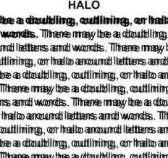
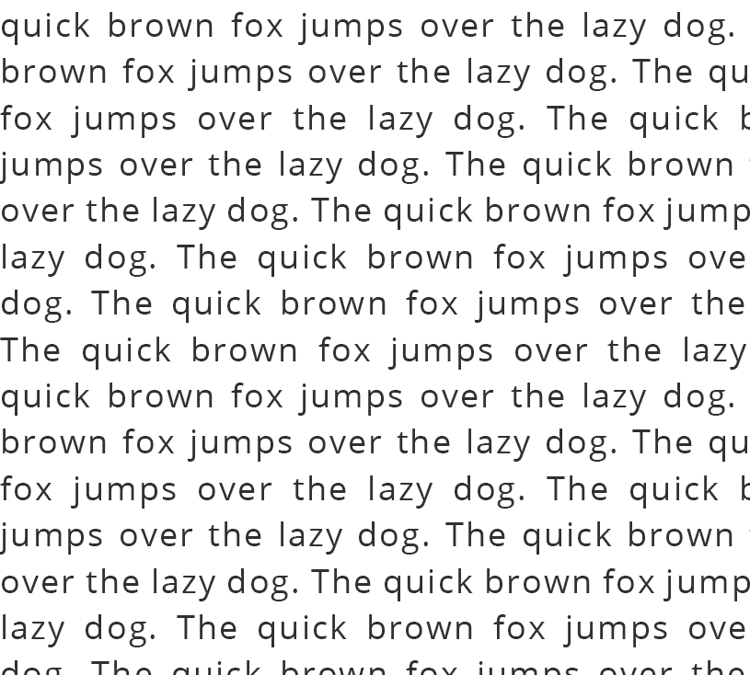
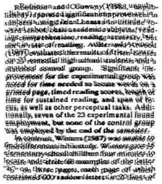
Dyslexia
Here is are some examples of the visual perception of a dyslexic person:
https://www.dyslexia.com/question/what-dyslexics-see/
Neurodiversity: Experiences & Perceptions

Slide 9
Dyslexia
When reading, dyslexic people they may say the wrong word, but it will probably look like the correct one e.g. form – from, who-how
They may also have directionality confusion when reading and writing
e.g. b-d, p-q, b-p, n-u, or m-w
https://www.dyslexia.com/question/what-dyslexics-see/
Neurodiversity: Experiences & Perceptions

Slide 10
Dyslexia
In recent years, work has been done to challenge the misconception that people with dyslexia are stupid
In fact, dyslexic people are often intelligent, with strengths in creativity, emotional intelligence, problem-solving, innovation, empathy, and intuition
Neurodiversity: Experiences & Perceptions

Slide 11
Dyslexia
Inclusive practices can help dyslexic people include:
Dictation Software
Coloured Overlays/Screens
Dyslexia-Friendly Font
Breaking Up Tasks
Visual Aids
Explicit Instructions
Repetition
Neurodiversity: Experiences & Perceptions

Slide 12
ASD
(Autism Spectrum Disorder)
ASD affects a person's communication, social interaction, and behaviour
Key features include differences in communication, a preference for routine/predictability, sensory processing differences, intense focused interests, and repetitive behaviours
https://www.autism.org.uk/
Neurodiversity: Experiences & Perceptions

Slide 13

ASD
(Autism Spectrum Disorder)
Stereotypes associated with this condition relate to the “Rainman” character:
Male
Good at maths
Incapable of eye contact
Devoid of empathy
Prone to noisy outbursts
Requires assisted living
Someone pitied or ridiculed by society
https://autismlearningpartners.com/debunking-autism-stereotypes/
Neurodiversity: Experiences & Perceptions

Slide 14
Neurodiversity: Experiences & Perceptions
ASD + Social Rejection
ASD can affect individuals with symptoms that impact their daily functioning
Navigating church and community events will be much harder for them
Feeling welcomed and accepted is something they may not experience a lot throughout their lives
https://reframingautism.org.au/friendship-loneliness-and-belonging-in-autistic-people/

Slide 15
Neurodiversity: Experiences & Perceptions
ASD + Social Rejection
Many people with ASD are told by society that they are stupid, unacceptable, embarrassing, irritating, unlikeable, or burdensome
The impact of this social rejection is devastating, with autistic individuals facing significantly higher suicide risks than neurotypical people
https://www.autism.org.uk/learn/knowledge-hub/professional-practice/suicide-research

Slide 16
Neurodiversity: Experiences & Perceptions
ASD + Masking
One response to social rejection is “masking” – this is when a person hides behaviours or needs that make their neurodiversity apparent
https://www.autism.org.uk/advice-and-guidance/behaviour/masking

Slide 17
Neurodiversity: Experiences & Perceptions
ASD + Masking
“Masking” involves scanning surroundings, policing behaviours, and/or overcompensating for symptoms
It can often result in shut down or burnout
Making church a space that embraces difference is an important step towards helping those with ASD feel safe enough not to mask
https://www.autism.org.uk/advice-and-guidance/behaviour/masking

Slide 18
Changing the Narrative
ASD is not a flaw - it is a different operating system
Creating a culture that celebrates ASD is integral to changing the damaging narratives around it
https://www.autism.org.uk/what-we-do/acceptance-and-awareness/world-autism-acceptance-month
Neurodiversity: Experiences & Perceptions

Slide 19
New Focus:
Hyper Focus
Loyal
Honest
Pattern Recognition
Deep Knowledge
Sensory Superpowers
Accepting
Excellent Memory
Hardworking
Deep empathy
Original
Attentive to Detail
Integrity
https://www.autistica.org.uk/what-is-autism/autistic-strengths
Neurodiversity: Experiences & Perceptions

Slide 20
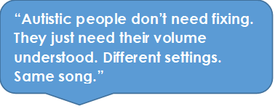
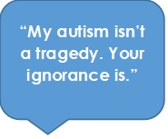
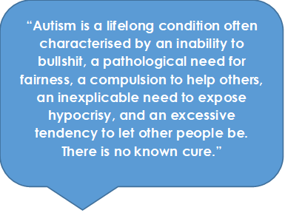
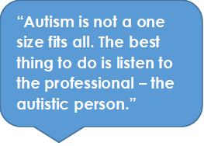
Listening:
https://www.autismspeaks.org/life-spectrum/autism-quotes
Neurodiversity: Experiences & Perceptions

Slide 21
ADHD + ADD
Attention Deficit Hyperactivity Disorder/Attention Deficit Disorder
ADHD/ADD symptoms arise from executive dysfunction
Executive functions are group of cognitive processes that regulate, control, and manage other cognitive processes
https://thinkadhd.co.uk/adhd-and/adhd-and-executive-functioning/
Neurodiversity: Experiences & Perceptions

Slide 22
ADHD + ADD
Attention Deficit Hyperactivity Disorder/Attention Deficit Disorder
ADHD/ADD can encompass difficulties in planning, organising, initiating tasks, and regulating emotions
People with attention deficits are prone to having difficulty processing verbal and nonverbal language
https://www.nhs.uk/conditions/adhd-adults/
Neurodiversity: Experiences & Perceptions

Slide 23
ADHD + ADD
Attention Deficit Hyperactivity Disorder/Attention Deficit Disorder
This can negatively impact their social interactions
They may drift off during conversations, miss social cues, and have difficulty learning social skills and etiquette that others take for granted
https://chadd.org/for-adults/relationships-social-skills/
Neurodiversity: Experiences & Perceptions

Slide 24
ADHD + ADD
Attention Deficit Hyperactivity Disorder/Attention Deficit Disorder
There are neurological reasons for why someone with ADD/ADHD might blurt out the wrong thing, talk over someone, forget things, lose their keys/books/phone, be unable to follow instructions, lose track of time and turn up late, or lack "common sense”
https://www.adhdcentre.co.uk/can-adhd-affect-social-skills/
Neurodiversity: Experiences & Perceptions

Slide 25
ADHD + ADD
Attention Deficit Hyperactivity Disorder/Attention Deficit Disorder
Criticising does not help, and simply compounds the shame that they internalise, which can lead to something known as Rejection Sensitive Dysphoria (RSD)
https://thinkadhd.co.uk/adhd-and/adhd-and-rejection-sensitivity-dysphoria-rsd/
Neurodiversity: Experiences & Perceptions

Slide 26
RDS
Rejection Sensitive Dysphoria
Children with ADHD/ADD experience 20,000 more micro-rejections than neurotypical children
“You’re embarrassing yourself”
“Why are you being lazy?”
“Stop biting your nails”
“Why are you crying?”
“Stop being dramatic”
“You’re too sensitive”
“Stop being weird”
“Stop fidgeting”
“Calm down”
“Be normal”
https://neuropathwaysclinic.co.uk/rejection-sensitive-dysphoria-children/
Neurodiversity: Experiences & Perceptions

Slide 27
RDS
Rejection Sensitive Dysphoria
This, combined with differences in neuropathways, can lead them to grow into adults who experience RSD
RDS results in intense, overwhelming emotional pain triggered by the perception of failing, being rejected, or criticized
https://my.clevelandclinic.org/health/diseases/24099-rejection-sensitive-dysphoria-rsd
Neurodiversity: Experiences & Perceptions

Slide 28
ADHD +ADD
Attention Deficit Hyperactivity Disorder/Attention Deficit Disorder
Once we look at the behaviours exhibited within ADHD/ADD as symptoms, rather than personal faults or weaknesses, we can look at ways to make reasonable adjustments
https://theadhdclinic.co.uk/blog/lesser-known-adhd-symptoms/
Neurodiversity: Experiences & Perceptions

Slide 29
ADHD +ADD
Attention Deficit Hyperactivity Disorder/Attention Deficit Disorder
Strategies that can help people with ADHD/ADD include:
Consistent routines
Timers, calendars, and alarms
Dividing tasks into manageable steps
Minimising distractions
Clear, concise instructions
Positive reinforcement
Visual aids
Movement breaks
Fidget toys
https://www.berkeleypsychiatrists.co.uk/blog/strategies-to-reduce-adhd-overwhelm-effective-coping-mechanisms-for-adults
Neurodiversity: Experiences & Perceptions

Slide 30

Inclusion, Accessibility & Engagement: Neurodiversity
Final Thoughts…
For the Church to embody Kingdom Values, we need to create a culture that embraces and supports neurodiversity, so those within this group feel welcome, accepted, and included
When in doubt, Think V E R A
Voices - are we listening to the voices of neurodiverse people?
Education - are we educating ourselves about neurodiversity?
Representation - is neurodiversity represented in our church?
Allyship - are we being allies to neurodiverse people in our community?

